Slide 1
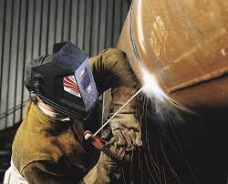
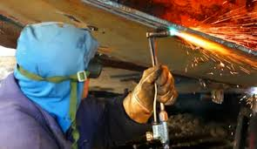

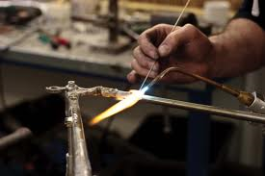
Welding, Soldering & Brazing
Department of Mechanical & Manufacturing Engineering

Slide 2
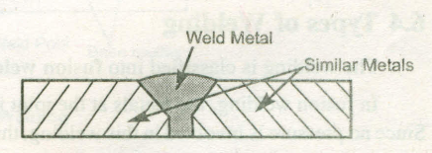
Welding
Welding is a process of joining two metal pieces by the application of heat, with or without the application of pressure and with or without the addition of filler material .
Applications:
Fabrication work, Construction work, Repair work etc.
-wherein metal plates, rolled steel sections, castings of ferrous metals, broken metal parts are welded together.
Department of Mechanical & Manufacturing Engineering

Slide 3
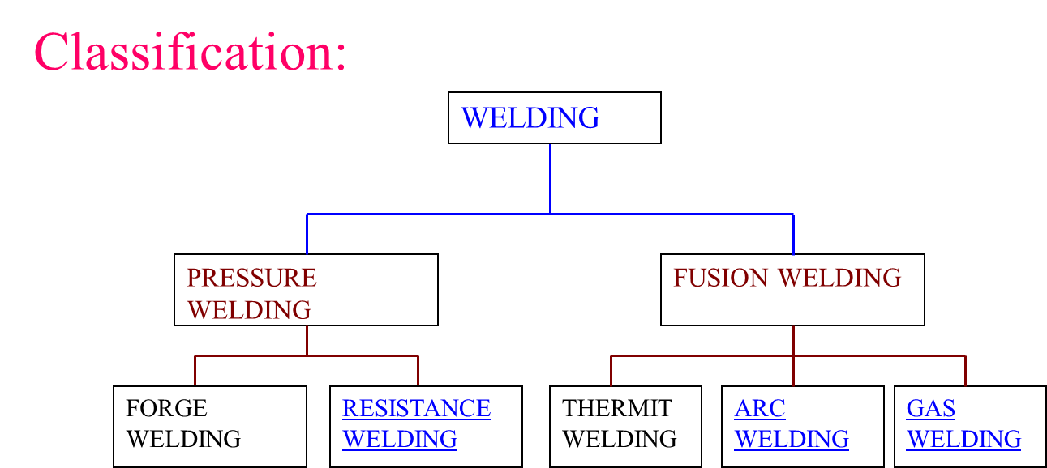
Department of Mechanical & Manufacturing Engineering

Slide 4
Resistance Spot Welding:
In resistance spot welding the metal pieces to be welded are heated to the plastic state over a limited area because of their resistance to the flow of electric current and external pressure is applied to complete the weld.
Department of Mechanical & Manufacturing Engineering

Slide 5
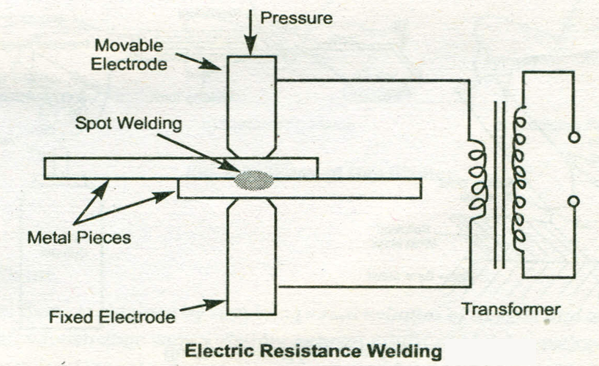
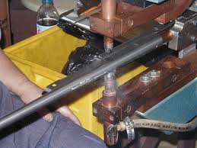
Resistance Spot Welding:
Department of Mechanical & Manufacturing Engineering

Slide 6
Resistance Spot welding
Uses the principle of pressure welding
Electrodes are positioned on either side of the sheet metal to be welded
Bottom electrode is fixed and the upper one is movable.
External pressure applied through the movable electrode.
Parts are heated by passing a heavy electric current.
Current encounters very high resistance at the joint, as a result temperature at the joint increases.
Department of Mechanical & Manufacturing Engineering

Slide 7
Resistance Spot welding
When temperature reaches plastic temperature of the parts external mechanical pressure is applied.
It is widely used in automobile industry for fabrication of car bodies, Sheet metal fabrication, ventilating ducts, domestic refrigerators etc.
Department of Mechanical & Manufacturing Engineering

Slide 8
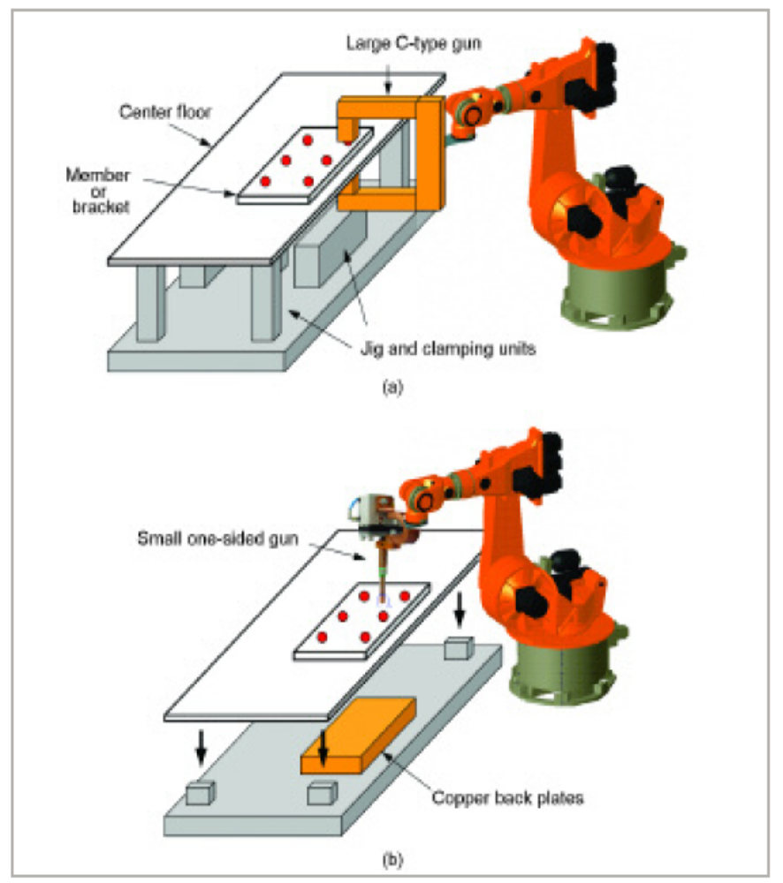
Department of Mechanical & Manufacturing Engineering

Slide 9
Advantages:
Less pollution
Efficient energy use
High production rates
Disadvantages:
Not suitable for joining thick metals
Equipment is costly
Department of Mechanical & Manufacturing Engineering

Slide 10
Electric Arc welding:
Arc welding is a fusion welding process in which welding is carried out by producing heat from an electric arc maintained between the work pieces and the electrode. External pressure is not applied in arc welding process. The electrode acts as the filler metal which is heated to its molten state and gets deposited on to the joint to complete the weld.
Department of Mechanical & Manufacturing Engineering

Slide 11
Electric Arc welding:
Electrode holder
Power source
(AC / DC)
Cables
Electrode
Clamp
Arc
Workpiece
Arc Welding Circuit
Department of Mechanical & Manufacturing Engineering

Slide 12
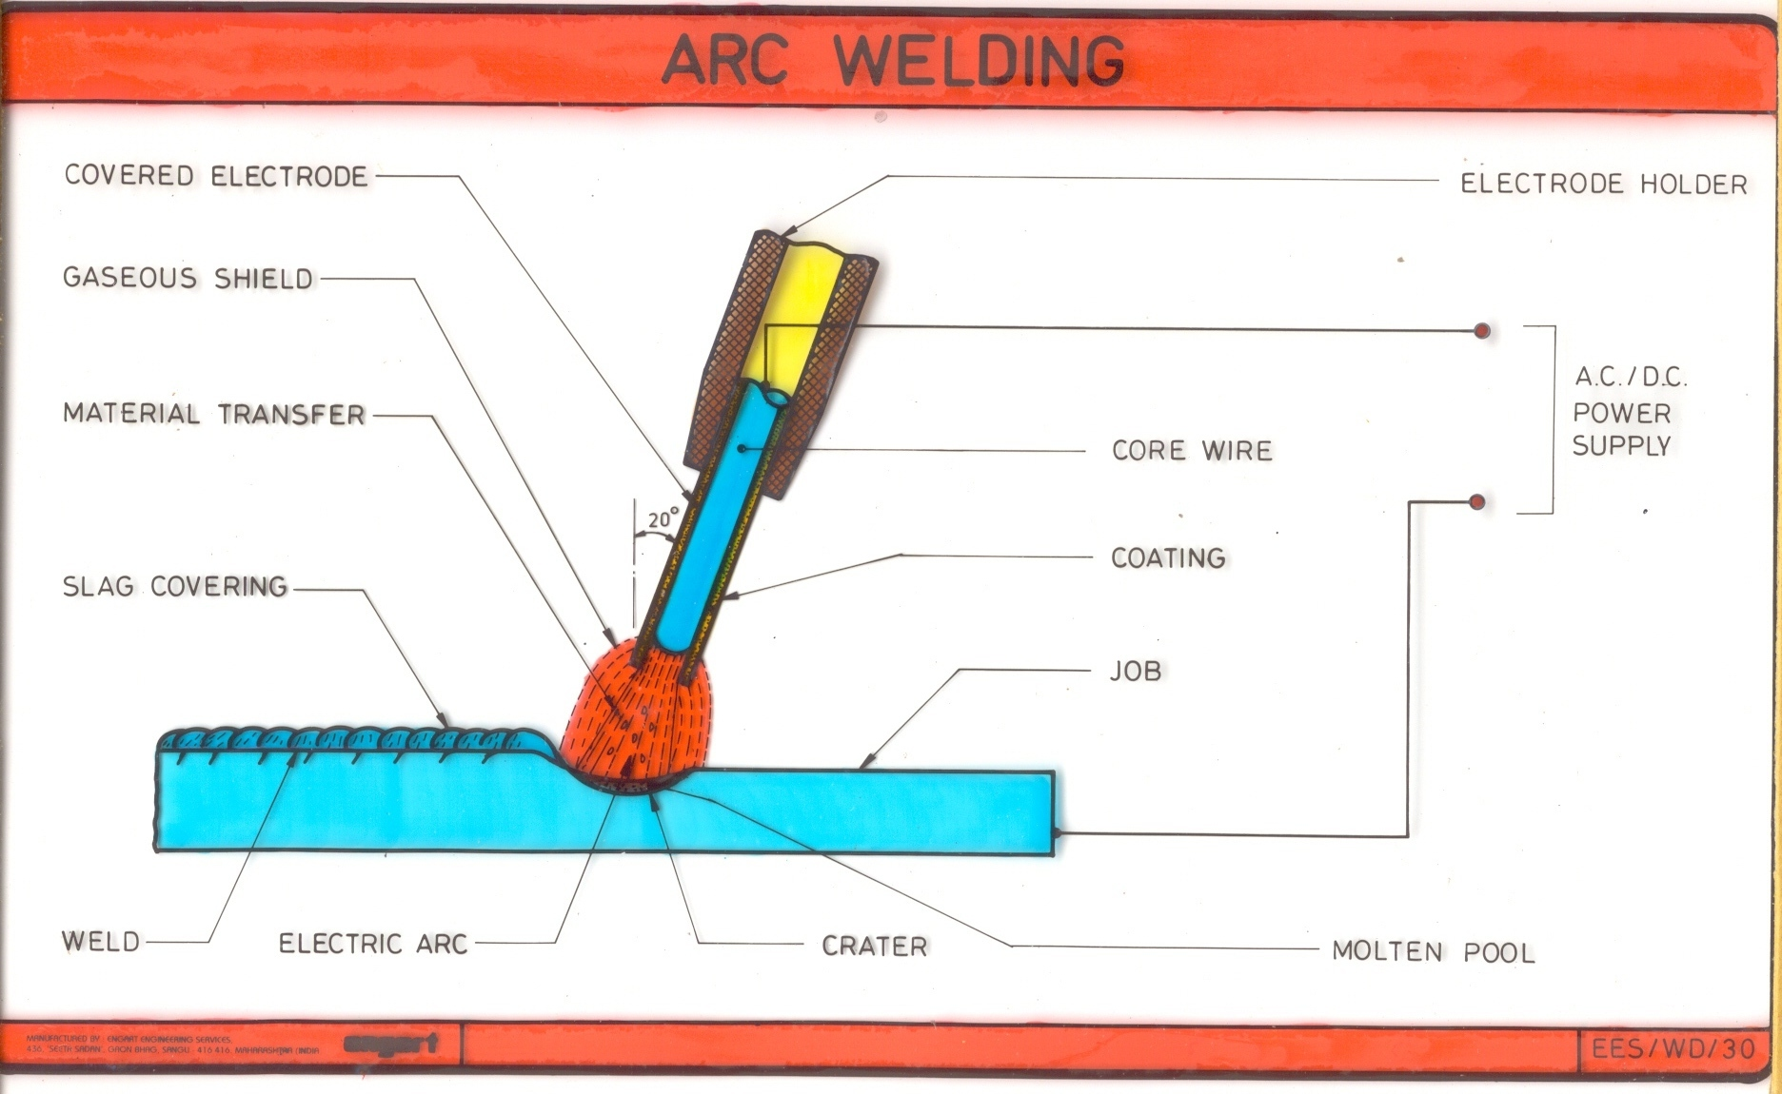
Department of Mechanical & Manufacturing Engineering

Slide 13
Electric Arc welding:
Plates to be welded will act as one pole of the electric circuit.
Electrode held by the operator forms the other pole.
When electrode comes in contact with the plates and separated by a small distance an electric arc is formed.
Intense heat of the arc melts the edges of two plates & creates a small molten metal pool.
Electrode tip also melts and filler metal enters the pool.
Strong joint is formed when molten metal cools & solidifies.
Department of Mechanical & Manufacturing Engineering

Slide 14
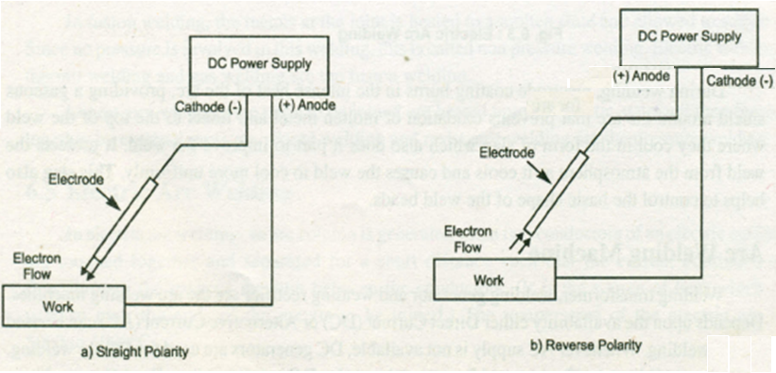
Arc Welding Power Source
AC arc welding –Step down transformer is used (200-440V to 80 -110 V)
High current (100-400 A )
DC arc welding – DC generator is used where direction of flow of electrons can be changed by using either Straight polarity or Reverse Polarity
Department of Mechanical & Manufacturing Engineering

Slide 15
Straight Polarity | Reverse Polarity
Electrode is connected with the negative terminal of the power source and base metals are connected with the positive terminal. | Base metals are connected with the negative terminal of the power source and electrode is connected with the positive terminal.
Under sufficient potential difference, electrons liberate from the tip of the electrode and strike the base plate surface. | Here electrons liberate from base plate surface and strike the electrode tip.
Proper fusion of the base metal can be achieved easily. | Due to less heat generation near base plate, incomplete fusion of the base plate may occur
Arc cleaning action (oxide cleaning) is poor. | Arc cleaning action is good.
DCSP is not suitable for welding thin plates. | DCSP is suitable for welding thin plates.
Metals with high melting temperature (such as stainless steel, titanium) can be suitably joined by DCSP. | Metals with low melting temperature (such as copper, aluminum) can be suitably joined by DCSP.
Department of Mechanical & Manufacturing Engineering

Slide 16
GAS WELDING (Oxy-Acetylene Welding)
Gas welding is a fusion welding process in which high temperature gas flame is used to raise the temperature of the work pieces so as to melt them at the junction and a filler material is used to complete the weld.
Commonly used gas mixtures are
1) oxygen and acetylene mixture
2) oxygen and hydrogen mixture
Of which oxygen and acetylene mixture is widely used.
Department of Mechanical & Manufacturing Engineering

Slide 17
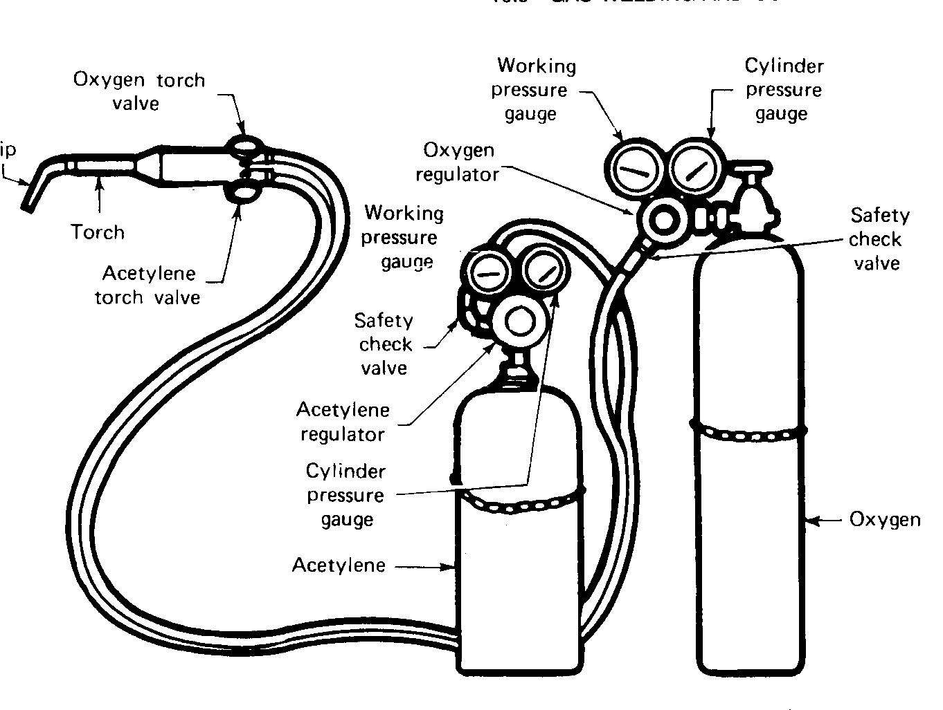
GAS WELDING EQUIPMENT
Department of Mechanical & Manufacturing Engineering

Slide 18



Oxy-Acetylene Gas Welding
Welding rod
Direction of welding
Torch Tip
Molten weld metal
Inner cone
Solidified weld metal
Base metal
Department of Mechanical & Manufacturing Engineering

Slide 19
Oxy-Acetylene Gas Welding
First the metal pieces to be welded are properly cleaned and placed near each other
The supply of oxygen and acetylene gases is regulated using the welding torch so as to get the desired flame.
The metal pieces are then heated to the melting temperature at the joint surface using the gas flame.
Department of Mechanical & Manufacturing Engineering

Slide 20
Oxy-Acetylene Gas Welding
A filler rod is brought very near to the joint and the flame.
Finally the filler rod and the torch tip are slowly advanced along the desired length of the joint to complete the weld.
Department of Mechanical & Manufacturing Engineering

Slide 21
GAS FLAMES
By regulating the flow of Oxygen and acetylene gases three gas flames can be obtained.
Neutral flame
Carburising flame
Oxidising flame
Department of Mechanical & Manufacturing Engineering

Slide 22
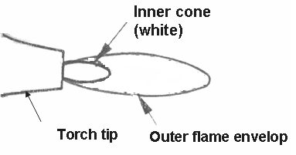
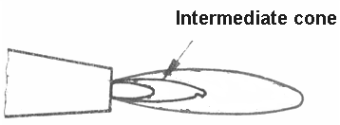
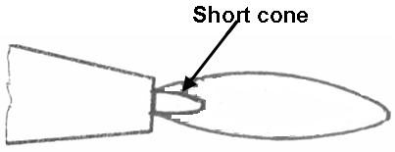
Gas welding flames
Neutral flame
Carburizing flame
Oxidizing flame
Department of Mechanical & Manufacturing Engineering

Slide 23
Gas welding flames
1. Neutral Flame
Obtained by mixing equal volumes of oxygen and acetylene gases.
It has an sharp inner cone which is white in colour surrounded by an outer envelope which is bluish in colour.
The inner cone provides the heat and the outer envelope protects the molten metal from oxidation.
The neutral flame is widely used for welding steel, alloy steels and cast iron.
Department of Mechanical & Manufacturing Engineering

Slide 24
Gas welding flames
2. Carburizing Flame
2. Carburizing Flame
This type of flame is obtained by supplying excess volumes of acetylene gas.
It is recognized by an intermediate cone known as “intermediate flame feather” between the inner cone and the outer bluish envelope. Its length is an indication of the amount of excess acetylene.
This flame is used for welding non ferrous metals and high carbon steels.
Department of Mechanical & Manufacturing Engineering

Slide 25
Gas welding flames
3. Oxidizing flame
This type of flame is obtained by supplying excess oxygen.
It is similar to the neutral flame except that the inner white cone is shorter in length.
It is not suitable for welding since the weld metal gets oxidized.
It is used in oxy acetylene gas cutting
Department of Mechanical & Manufacturing Engineering

Slide 26
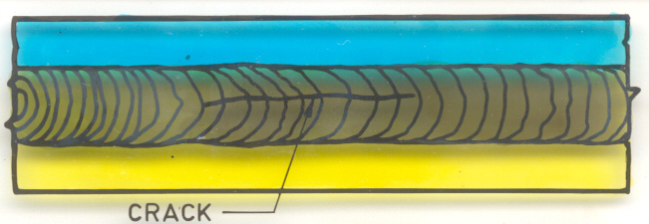
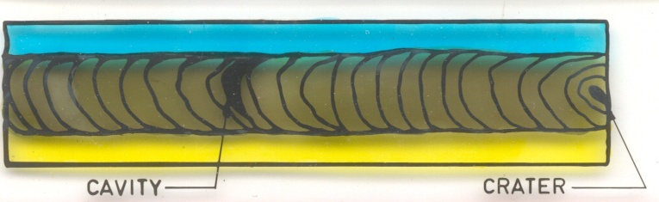
WELDING DEFECTS
Cracking
  Due to incorrect electrodes / wrong procedure
Incorrect Edge preparation
  Too Narrow angle between edges result in weak weld
  Tool wide angle between edges results in overheating
Craters
  Concave depressions in the external surface of the joint
Department of Mechanical & Manufacturing Engineering

Slide 27
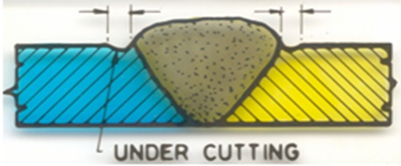
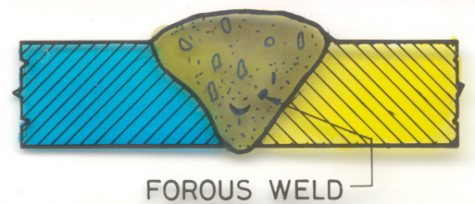
WELD DEFECTS
4.Under-cutting
  Excess melting of parent metal which reduces its strength
5.Porous weld
  Due to Insufficient gap between electrode, presence of moisture content in the electrode or presence of gases in base metal.
POROUS WELD
Department of Mechanical & Manufacturing Engineering

Slide 28
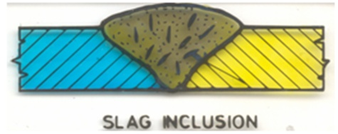
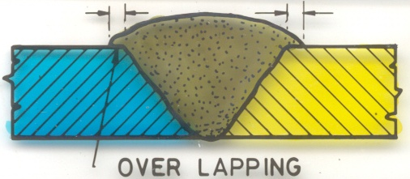
WELD DEFECTS
6.Slag inclusion
  Due to wrong welding procedure, high density flux or
  insufficient gap
7. Over lapping
  Excess melting of filler material, wrong welding procedure
Department of Mechanical & Manufacturing Engineering

Slide 29
SOLDERING & BRAZING
Department of Mechanical & Manufacturing Engineering

Slide 30
SOLDERING
Soldering is a process of joining thin pieces of metal using a fusible alloy called the solder and by the application of heat.
Soldering is extensively used in sheet metal work and in joining electrical and electronic circuits.
The solder used is an alloy of lead and tin. Higher the percentage of tin lower will be the melting temperature of the solder.
Department of Mechanical & Manufacturing Engineering

Slide 31
SOLDERING
The parts to be soldered are first thoroughly cleaned to make them free from dust, oil, scales etc. and are placed in position.
Then the joining surfaces are coated with a flux usually zinc chloride.
The soldering iron is then heated to the desired temperature electrically.
After heating the soldering iron it is rubbed on the solder. The solder melts and spreads over the hot surface of the bit and forms a coating over it.
This enables the bit to pick up the molten solder and deposit it as required on the joint surface. The joint is then allowed to cool so that the molten solder solidifies.
Department of Mechanical & Manufacturing Engineering

Slide 32
SOLDERING
Soft solder
  Alloy of lead and tin
  Melting temperature, 150 – 350⁰C
  Used for lighter joints
Hard solder
  Alloy of copper , tin and silver
  Soldering temperature, 600 – 900⁰C
  Used for stronger joints
Department of Mechanical & Manufacturing Engineering

Slide 33
BRAZING
The method of joining two similar or dissimilar metals using a special fusible alloy called spelter having a melting point of greater than 450ºC but lower than the melting point of the parts to be joined is called Brazing.
The materials used in brazing are copper base and silver base alloys.
Brazing is used in many applications such as pipe fittings, carbide tips of tools, radiators, heat exchangers etc.
Department of Mechanical & Manufacturing Engineering

Slide 34
BRAZING
The parts to be joined are first cleaned to remove dirt, oxides, grease and other impurities.
Flux is then applied along the line of the joint. Usually Borax or Boric acid is used as flux in brazing
After the flux is applied the joint is heated to the required brazing temperature using an oxy-acetylene welding torch.
The solid filler metal then placed on the joint melts and flows by capillary action into the joint space and sticks to the surface by adhesion which on cooling produces a strong joint.
Department of Mechanical & Manufacturing Engineering

Slide 35
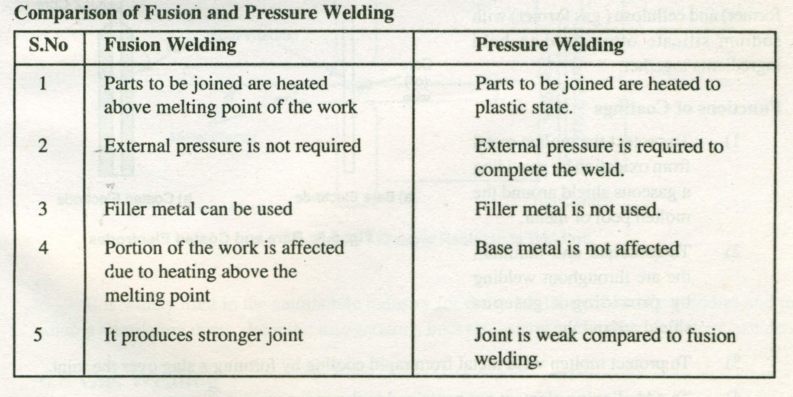
Department of Mechanical & Manufacturing Engineering

Slide 36
Comparison between Brazing and Soldering
Brazing | Soldering
Melting point of the filler material is above 450⁰C
Melting point of the filler material is below 450⁰C
Similar/Dissimilar metals can be joined
Only similar metals can be joined
Poor surface finish.
Good surface finish
Stronger joints
Weaker joints
Department of Mechanical & Manufacturing Engineering

